Slide 1
Reinforcement Learning
© 2025 Virginia Polytechnic Institute and State University. All rights reserved.

Slide 2
At the end of this module, you should be able to:
Understand when you would want to use reinforcement learning
Explain the terminology and the process of learning associated with reinforcement learning
Describe various types of reinforcement learning and use cases

Slide 3
Reinforcement Learning

Slide 4
Introduction to Machine Learning Course Roadmap
What is the goal of the data analysis?
Predict an output |  |  |  |  |  | Reveal patterns or relationships |  | Make decisions using an autonomous agent
Supervised Learning (Output in the data set) |  |  |  |  |  | Unsupervised Learning (No output in the data set) |  | Reinforcement Learning* (Supervised & unsupervised)
Continuous or discrete output? |  |  |  |  |  | What is the subgoal? |  | Does a model exist?
Continuous |  |  | Discrete |  |  | Identify groups | Reduce dimensions | Model Based | Model Free
Simple linear regression Multiple linear regression Subset selection Ridge regression & LASSO PCR & PLS | Polynomial regression Step functions Splines Local regression General additive models | Decision tree Random forest Neural network Gradient boosting tree | Logistic regression Linear discriminant analysis Quadratic discriminant analysis | Decision tree Random forest Neural network Gradient boosting tree | Support vector machines | Hierarchical clustering K-means clustering | Principal components analysis | Given the model Learn the model | Policy Optimization Q-Learning
Reinforcement Learning Overview
*Advanced Topic: Bonus module if time

Slide 5
Reinforcement Learning

Slide 6
Recall supervised and unsupervised learning
Some tangible measurement(s)
“The Black Box”
INPUTS
MACHINE LEARNING MODEL
OUTPUT(S)
Supervised Learning
In the context of domain knowledge
“The Black Box”
INPUTS
MACHINE LEARNING MODEL
PATTERNS,
RELATIONSHIPS, STRUCTURE
Unsupervised Learning
does it make sense?
Notes:
So far in this course, we have focused on SL and UL

Slide 7
Reinforcement learning (RL) is a different class of ML
Reward Optimization
“The Black Box”
INPUTS
MACHINE LEARNING MODEL
ACTION(S)
Reinforcement Learning

Slide 8
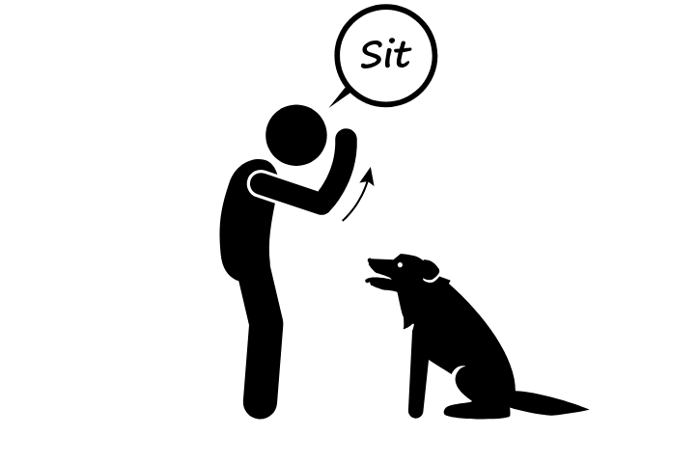
Dog Training: A Non-ML RL example
Notes:
Use this slide to motivate how RL works
Gently introduce terms before formally introducing later
Agent: Dog
Envrionment: Interacting with trainer
State: Changes from sitting to standing
Reward: Dog gets a treat

Slide 9
Motivating examples of RL
Autonomous vehicles
Robotics control
Smart grid energy management
Industrial automation
Cybersecurity
Notes:
Notes to add color commentary around naval applications for Dahlgren course:
1. Autonomous Underwater Vehicles (AUVs) – Path Planning and Navigation
Application: RL is used to train AUVs to navigate complex underwater environments (e.g., seabed mapping, mine detection, surveillance) while avoiding obstacles and managing energy.
Example Techniques:
Deep Q-Networks (DQN) for discrete decision-making
Policy Gradient methods for continuous steering control
Real-World Example:
Naval Research Laboratory (NRL): Work on RL for persistent AUV navigation in uncertain ocean environments with dynamic obstacles.
Reference:
Chen, W., et al. (2018). Deep reinforcement learning for autonomous underwater vehicle path planning in unknown ocean environments. OCEANS 2018.
2. Multi-Agent Coordination in Swarms or Fleets
Application: RL helps coordinate multiple autonomous naval platforms (e.g., unmanned surface vessels, AUVs) for formation control, cooperative search, or area coverage.
Example Techniques:
Multi-Agent Deep RL (MADRL)
Actor-Critic with centralized training, decentralized execution
Reference:
Lowe, R., et al. (2017). Multi-agent actor-critic for mixed cooperative-competitive environments. NeurIPS.
Liu, C., et al. (2022). Cooperative multi-agent reinforcement learning for maritime search and rescue planning. Ocean Engineering.
3. Anti-Submarine Warfare (ASW) and Target Tracking
Application: RL models can optimize sonar deployment, search patterns, or tracking behaviors in stochastic underwater environments.
Example Techniques:
Partially Observable Markov Decision Processes (POMDPs)
Bayesian RL for belief updates over hidden target states
Research Use Case: Optimizing search strategies for locating a submarine in noisy conditions, using Q-learning or Monte Carlo Tree Search with belief states.
Reference:
Yliniemi, L., & Tumer, K. (2014). Multi-objective multi-agent decision making in simulated naval scenarios. Proceedings of GECCO.
4. Energy Management in Naval Power Systems
Application: Use RL to optimize power distribution aboard electric ships, especially in dynamic conditions with variable loads (e.g., weapons, propulsion, sensors).
Example Techniques:
Model Predictive RL
Continuous Control (e.g., DDPG, PPO)
Reference:
Liu, J., et al. (2018). Reinforcement learning-based energy management of all-electric ships considering voyage plan. IEEE Transactions on Transportation Electrification.
5. Cybersecurity and Intrusion Response on Naval Networks
Application: Use RL for real-time defense policies in detecting and mitigating cyber threats aboard naval vessels.
Example Techniques:
Game-theoretic RL
Adversarial RL for Red Team vs Blue Team simulations
Reference:
Miehling, E., et al. (2015). A POMDP approach to dynamic cyber-security defense. IEEE CDC.
6. Naval Logistics and Mission Planning
Application: Optimize ship routing, supply chain scheduling, or mission allocation using RL under uncertainty and dynamic weather/ocean conditions.
Example Techniques:
Hierarchical RL
Deep Q-learning for sequential routing
Reference:
Zhang, H., et al. (2020). Reinforcement learning-based dynamic mission planning for naval operations in uncertain environments. Journal of Defense Modeling and Simulation.

Slide 10
RL is used for sequential decision making
A computational approach to learning from interaction to achieve a goal.
Agents interact with their environment by taking actions and receiving rewards.
Active versus passive
Not learning from labelled data
Advance through various states over time by taking actions to maximize a reward

Slide 11
Reinforcement Learning

Slide 12
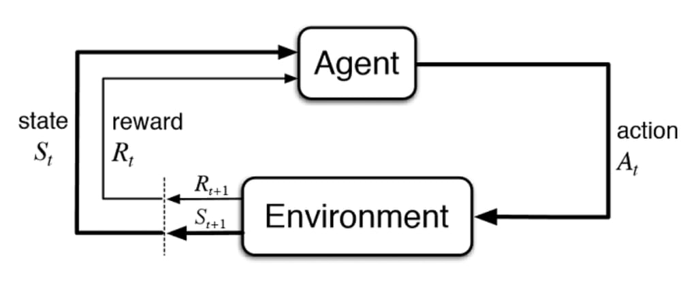
Agents interact with the environment by executing actions, making observations, and receiving awards

Slide 13
Actions are things agents can do in the environment
Discrete → finite set, mutually exclusive (e.g., move left OR right)
Continuous →→ value on continuous scale (e.g., turning wheel at angle/direction of steering)

Slide 14
The environment is everything outside of the agent (in general sense)

Slide 15
Reward is a scalar value periodically obtained from the environment that drives the learning process
Positive or negative
Large or small
Notes:
Commonly updated at each timestep or interaction
Reinforcement because reward obtained by agent reinforces current behavior

Slide 16
A state is a representation of the environment at a specific point in time that the learning agent uses to decide what to do next
Notes:
Commonly updated at each timestep or interaction
Reinforcement because reward obtained by agent reinforces current behavior

Slide 17
Reinforcement Learning

Slide 18




Should you carry your umbrella today?
Let’s consider this simple toy example
Can you the identify agent, environment, action, states, and rewards?
?
Notes:
You're trying to learn whether you should take an umbrella when you leave for work.
Each morning, you decide: Take Umbrella (Action A1) or Don't Take Umbrella (Action A2).
The chance of rain is 50%, but you don’t know that at first.
You learn over time by getting feedback: did it rain or not?
Agent – you
Action – carry/not carry umbrella
Environment – Outdoors
States – Rain/Sun
Rewards – 1 if you stay dry; 0 if you get wet
Obviously this isn’t realistic, we would probably make a choice to carry our umbrella on the weather forecast but not on random chance but let’s suspend our disbelief.

Slide 19
You're trying to learn whether you should take an umbrella when you leave for work
Each morning, you decide: Take Umbrella (Action A1) or Don't Take Umbrella (Action A2).
The chance of rain is 50%, but you don’t know that at first.
You learn over time by getting feedback: did it rain or not?

Slide 20
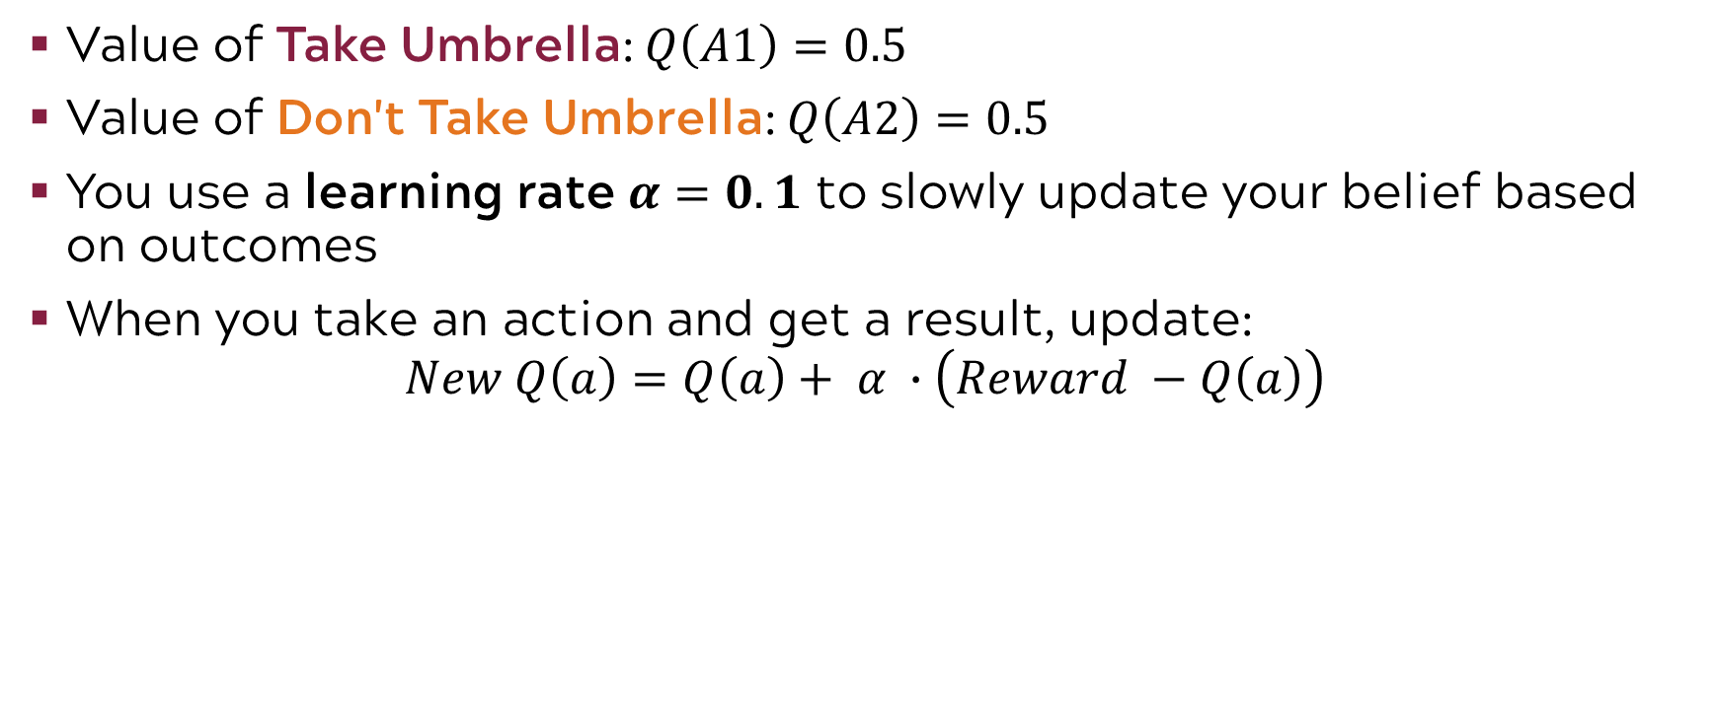
You start with equal guesses for both choices
Value of Take Umbrella: $Q\left(A1\right)=0.5$
Value of Don't Take Umbrella: $Q\left(A2\right)=0.5$
You use a learning rate $α=0.1$ to slowly update your belief based on outcomes
When you take an action and get a result, update:
$$New Q\left(a\right)=Q\left(a\right)+ α ∙\left(Reward −Q\left(a\right)\right)$$

Slide 21
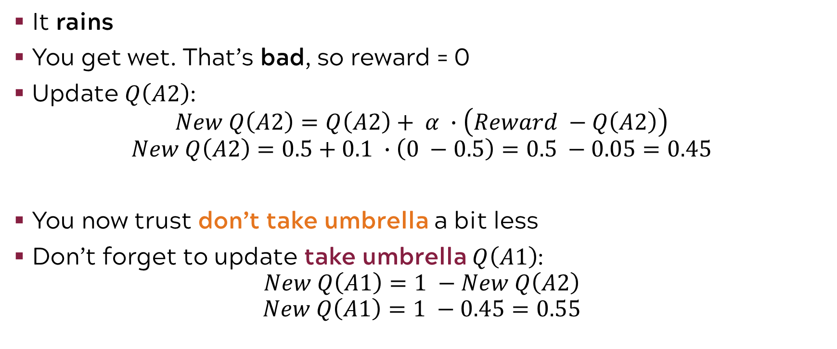
Day 1: 50/50, so you choose don’t take umbrella (A2)
It rains
You get wet. That’s bad, so reward = 0
Update $Q\left(A2\right)$:
$$New Q\left(A2\right)=Q\left(A2\right)+ α ∙\left(Reward −Q\left(A2\right)\right)$$
$$New Q\left(A2\right)=0.5+0.1 ∙\left(0 −0.5\right)=0.5 −0.05=0.45$$
You now trust don’t take umbrella a bit less
Don’t forget to update take umbrella $Q\left(A1\right)$:
$$New Q\left(A1\right)=1 −New Q\left(A2\right)$$
$$New Q\left(A1\right)=1 −0.45=0.55$$

Slide 22
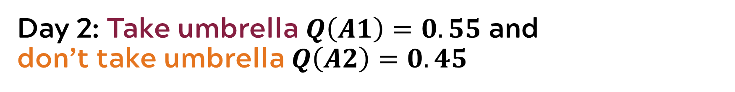
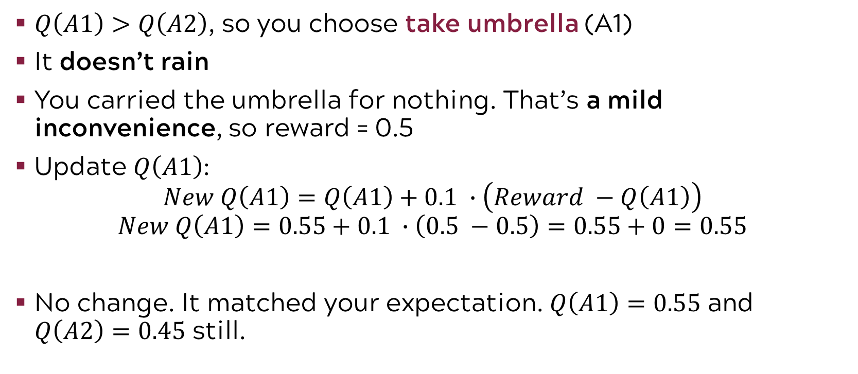
Day 2: Take umbrella $Q\left(A1\right)=0.55$ and don’t take umbrella $Q\left(A2\right)=0.45$
$Q\left(A1\right)>Q\left(A2\right)$, so you choose take umbrella (A1)
It doesn’t rain
You carried the umbrella for nothing. That’s a mild inconvenience, so reward = 0.5
Update $Q\left(A1\right)$:
$$New Q\left(A1\right)=Q\left(A1\right)+0.1 ∙\left(Reward −Q\left(A1\right)\right)$$
$$New Q\left(A1\right)=0.55+0.1 ∙\left(0.5 −0.5\right)=0.55+0=0.55$$
No change. It matched your expectation. $Q\left(A1\right)=0.55$ and $Q\left(A2\right)=0.45$ still.

Slide 23
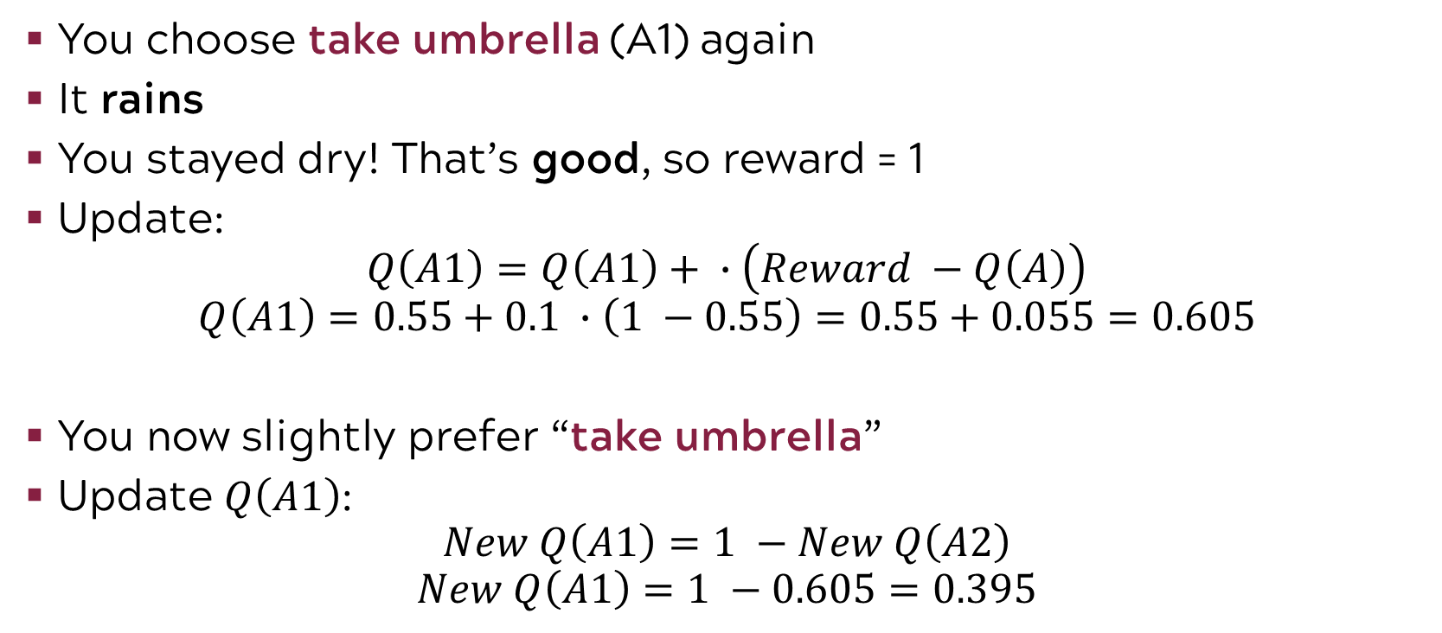
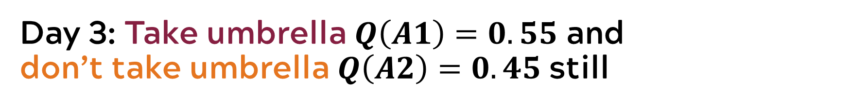
Day 3: Take umbrella $Q\left(A1\right)=0.55$ and don’t take umbrella $Q\left(A2\right)=0.45$ still
You choose take umbrella (A1) again
It rains
You stayed dry! That’s good, so reward = 1
Update:
$$Q\left(A1\right)=Q\left(A1\right)+ ∙\left(Reward −Q\left(A\right)\right)$$
$$Q\left(A1\right)=0.55+0.1 ∙\left(1 −0.55\right)=0.55+0.055=0.605$$
You now slightly prefer “take umbrella”
Update $Q\left(A1\right)$:
$$New Q\left(A1\right)=1 −New Q\left(A2\right)$$
$$New Q\left(A1\right)=1 −0.605=0.395$$

Slide 24
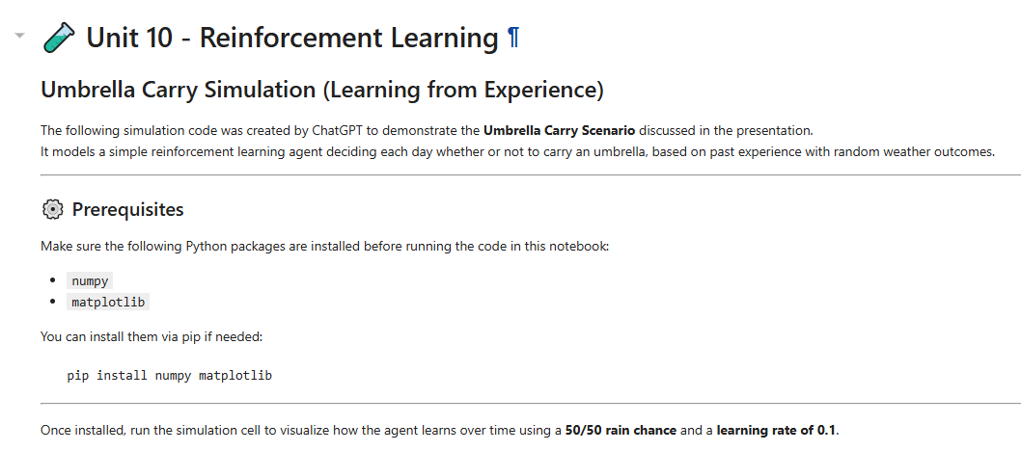
Exercise: Run the umbrella simulation code to see what happens after 30 days

Slide 25
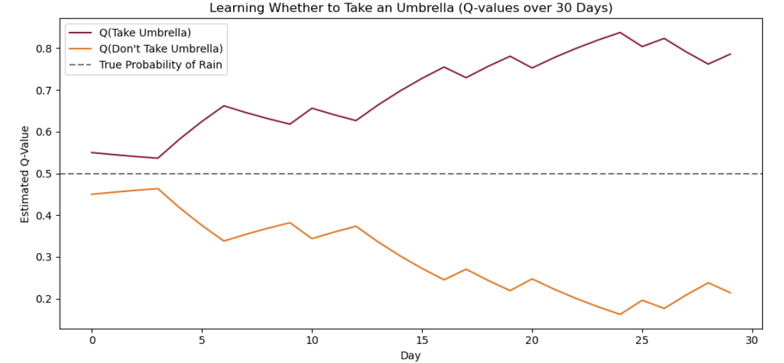
Learning whether to take an umbrella over time

Slide 26
Reinforcement Learning

Slide 27
A taxonomy of RL methods
All methods can be classified into various aspects:
Model-Free or Model-Based
Model-Free:
Policy-Based or Value-Based
Policy-Based:
On-Policy or Off-policy
Value-Based:
Directly approximate policy of agents (i.e. probability distribution over available actions)
Agent calculates value of every possible action and chooses action with best value
Agent does computations on current observations to determine next action
Usually easier to train
Model-Based:
Tries to predict next observation or reward and choose best possible action
Deterministic environments
On-Policy:
Rely on training data to be sampled according to current policy we’re updating
Off-Policy:
Method has ability to learn on historical data (from previous version of agent or seen by same agent a few episodes ago)
Require “fresh data”

Slide 28
Reinforcement Learning

Slide 29
Introduction to Machine Learning Course Roadmap
What is the goal of the data analysis?
Predict an output |  |  |  |  |  | Reveal patterns or relationships |  | Make decisions using an autonomous agent
Supervised Learning (Output in the data set) |  |  |  |  |  | Unsupervised Learning (No output in the data set) |  | Reinforcement Learning* (Supervised & unsupervised)
Continuous or discrete output? |  |  |  |  |  | What is the subgoal? |  | Does a model exist?
Continuous |  |  | Discrete |  |  | Identify groups | Reduce dimensions | Model Based | Model Free
Simple linear regression Multiple linear regression Subset selection Ridge regression & LASSO PCR & PLS | Polynomial regression Step functions Splines Local regression General additive models | Decision tree Random forest Neural network Gradient boosting tree | Logistic regression Linear discriminant analysis Quadratic discriminant analysis | Decision tree Random forest Neural network Gradient boosting tree | Support vector machines | Hierarchical clustering K-means clustering | Principal components analysis | Given the model Learn the model | Policy Optimization Q-Learning
Reinforcement Learning Overview
*Advanced Topic: Bonus module if time

Slide 30
Now you should be able to:
Understand when you would want to use reinforcement learning
Explain the terminology and the process of learning associated with reinforcement learning
Describe various types of reinforcement learning and use cases

